Slide 1
ACKNOWLEDGEMENT
In the completion of this project successfully many people have best owned upon me their blessings and heart pledged support, this time I am utilizing to thank all the people who have been considered with this project.
I would like to thank my principal and my chemistry teacher Mrs. Beenu Bhalla whose valuable guidance has been the ones that helped me complete this project and make it a success, his suggestions and his instructions served as a major contribution towards the completion of this project. Then I would like to thank my parents and friends who have helped me with their valuable suggestions

Slide 2
INTRODUCTION
DYEING
Dyeing is the application of dyes or pigments on textile materials such as fibers, yarns, and fabrics with the objective of achieving color with desired fastness. Dyeing is normally done in a special solution containing dyes and particular chemical material. Dye molecules are fixed to the fiber by absorption, diffusion, or bonding with temperature and time being key controlling factors. The bond between dye molecule and fiber may be strong or weak, depending on the dye used. Dyeing and printing are different applications; in printing color is applied to a localized area with desired patterns and in dyeing it is applied to the entire textile.
The primary source of dye, historically, has been nature, with the dyes being extracted from animals or plants. Since the mid-19th century, however, humans have produced artificial dyes to achieve a broader range of colors and to render the dyes more stable to washing and general use. Different classes of dyes are used for different types of fiber and at different stages of the textile production process, from loose fibers through yarn and cloth to complete garments.
Acrylic fibers are dyed with basic dyes, while nylon and protein fibers such as wool and silk are dyed with acid dyes, and polyester yarn is dyed with disperse dyes. Cotton is dyed with a range of dye types, including vat dyes, and modern synthetic reactive and direct dyes.

Slide 3
DYEING HISTORY
The earliest dyed flax fibers have been found in a prehistoric cave in the Republic of Georgia and date back to 34,000 BC. More evidence of textile dyeing dates back to the Neolithic period at the large Neolithic settlement at Çatalhöyük in southern Anatolia, where traces of red dyes, possibly from ocher, an iron oxide pigment derived from clay, were found.^{[5]} In China, dyeing with plants, barks, and insects has been traced back more than 5,000 years. Early evidence of dyeing comes from Sindh province in Pakistan, where a piece of cotton dyed with a vegetable dye was recovered from the archaeological site at Mohenjo-daro (3rd millennium BCE). The dye used in this case was madder, which, along with other dyes such as indigo, was introduced to other regions through trade. Natural insect dyes such as Cochineal and kermes and plant-based dyes such as woad, indigo and madder were important elements of the economies of Asia and Europe until the discovery of man-made synthetic dyes in the mid-19th century.
The first synthetic dye was William Perkin's mauveine in 1856, derived from coal tar. Alizarin, the red dye present in madder, was the first natural pigment to be duplicated synthetically in 1869, a development which led to the collapse of the market for naturally grown madder. The development of new, strongly colored synthetic dyes followed quickly, and by the 1870s commercial dyeing with natural dyestuffs was disappearing.

Slide 4
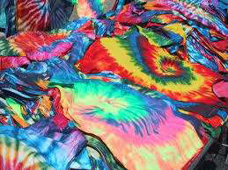
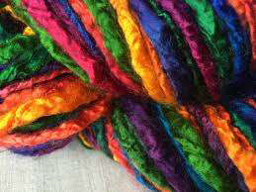
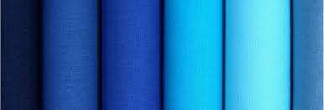
Acrylic fibers are dyed with basic dyes.
Nylon and Protein fibers such as Wool and Silk are
dyed with acid dyes
Polyester yarn is dyed with disperse dyes.
Cotton is dyed with a range of dye types, including vat
dyes, and modern synthetic reactive and direct dyes.

Slide 5
Types of Dyes (Major types) : ✓ Acid dyes: These are azo dyes and are characterized by the presence of acidic groups. ✓ Basic dyes: These dyes contain organic basic groups such as NH2 or NR2. ✓ Direct dyes: These are also azo dyes and are used to dye the fabrics directly by placing in aqueous solution of the dye. ✓ Disperse dyes: These dyes are applied in the form of a dispersion of minute particles of the dye in soap solution in the presence of phenol or benzoic acid. ✓ Vat dyes: These dyes are water-insoluble and before dyeing these are reduced to colour less compounds in wooden vats by alkaline reducing agents.

Slide 6
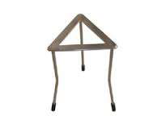
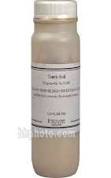
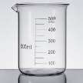
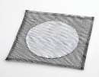

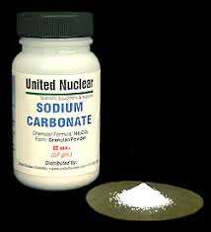
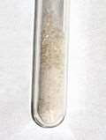
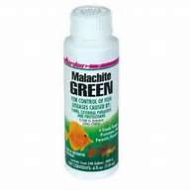
EXPERIMENT ◻ Aim: To dye wool and cotton clothes with malachite green. ◻ Requirements: 500 ml beakers, tripod stand, wire gauze, glass rod, spatula, wool cloth and cotton cloth. Sodium carbonate, tannic acid, tartaremetic acid and malachite green dye.
BEAKER TRIPOD STAND TANNIC ACID
WIRE GAUZE GLASS ROD SODIUM
TARTAREMETIC MALACHITE

Slide 7
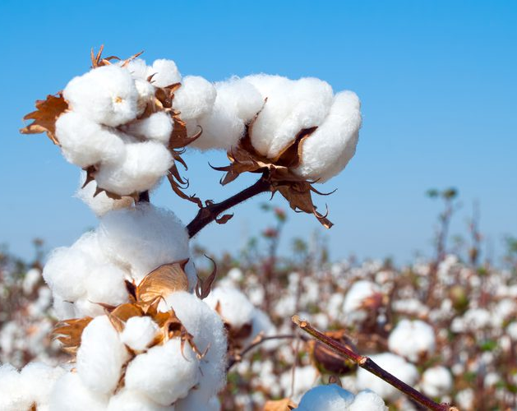
Cotton is a soft, fluffy staple fiber that grows in a boll, or protective case, around the seeds of the cotton plants of the genus Gossypium in the mallow family Malvaceae. The fiber is almost pure cellulose. Under natural conditions, the cotton bolls will increase the dispersal of the seeds.
COTTON

Slide 8
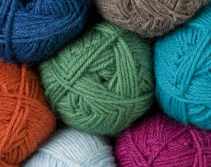
Wool is the textile fiber obtained from sheep and other animals, including cashmere and mohair from goats, qiviut from muskoxen, angora from rabbits, and other types of wool from camelids.^{[1]} Wool consists of protein together with a few percent lipids. In this regard it is chemically quite distinct from the more dominant textile, cotton, which is mainly cellulose.
WOOL

Slide 9
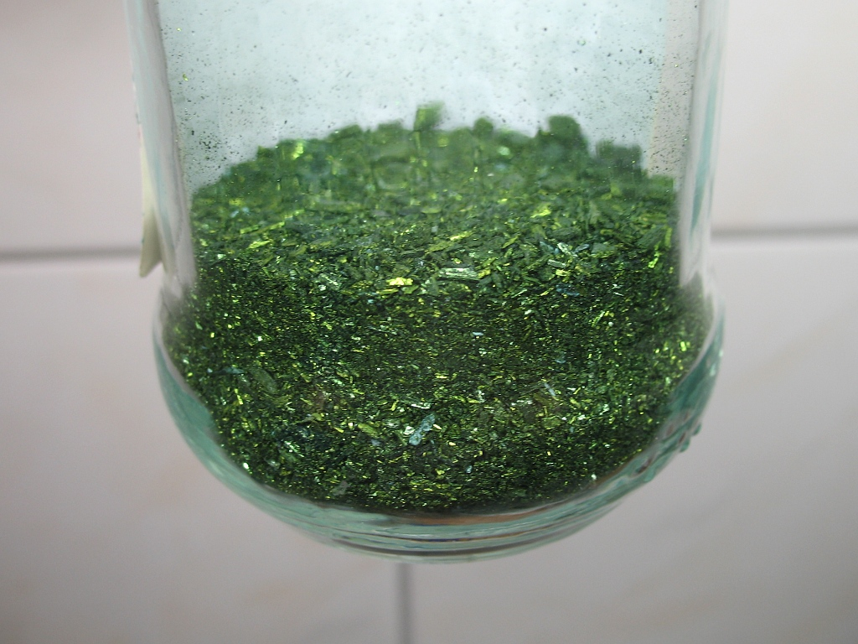
Malachite green is an organic compound that is used as a dyestuff and controversially as an antimicrobial in aquaculture. Malachite green is traditionally used as a dye for materials such as silk, leather, and paper. Despite its name the dye is not prepared from the mineral malachite, and the name just comes from the similarity of color.
MALACHITE GREEN

Slide 10
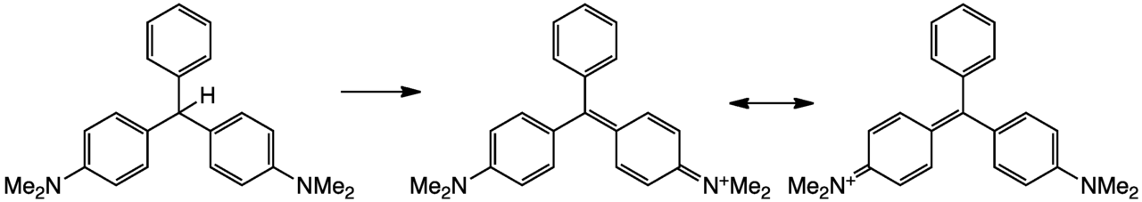
Malachite green is classified in the dyestuff industry as a triarylmethane dye and also using in pigment industry. Formally, malachite green refers to the chloride salt [C₆H₅C(C₆H₄N(CH₃)₂)₂]Cl, although the term malachite green is used loosely and often just refers to the colored cation. The oxalate salt is also marketed. The anions have no effect on the color. The intense green color of the cation results from a strong absorption band at 621 nm (extinction coefficient of 10⁵ M⁻¹ cm⁻¹).
Malachite green is prepared by the condensation of benzaldehyde and dimethylaniline to give leucomalachite green (LMG):
C₆H₅CHO + 2 C₆H₅N(CH₃)₂ → C₆H₅CH(C₆H₄N(CH₃)₂)₂ + H₂OSecond, this colorless leuco compound, a relative of triphenylmethane, is oxidized to the cation that is MG:
C₆H₅CH(C₆H₄N(CH₃)₂)₂ + HCl + ​¹⁄₂ O₂ → [C₆H₅C(C₆H₄N(CH₃)₂)₂]Cl + H₂OA typical oxidizing agent is manganese dioxide.

Slide 11
OBSERVATIONS
➢ The colour of wool cloth directly by dipping in hot solution of malachite green dye is fast.
➢ The colour of cotton cloth dyed directly (without using mordant) by dipping in hot solution of
malachite green is not fast to washing and is of low intensity.
➢ The colour of cotton cloth dyed indirectly by using mordant and then by dipping in hot solution of malachite green is fast to washing and is of high intensity.
PRECAUTIONS
▪ Let the Malachite Green solution boil properly for about 8-10 minutes to get better results.
▪ While dyeing cotton directly, let the cotton cloth be present in the dye for more than or
equal to 2 minutes but not less.
▪ Using of solutions such as tartaremetic Solution, tannic acid solution must be eminent.
▪ Usage of gloves is preferable to ensure tidiness.

Slide 12
THANK YOU BY – ADITYA CLASS – XII – B ROLL NO.

